Slide 1
Behavioral Patterns
Part 1
Chain of Responsibility, Mediator, Observer

Slide 2
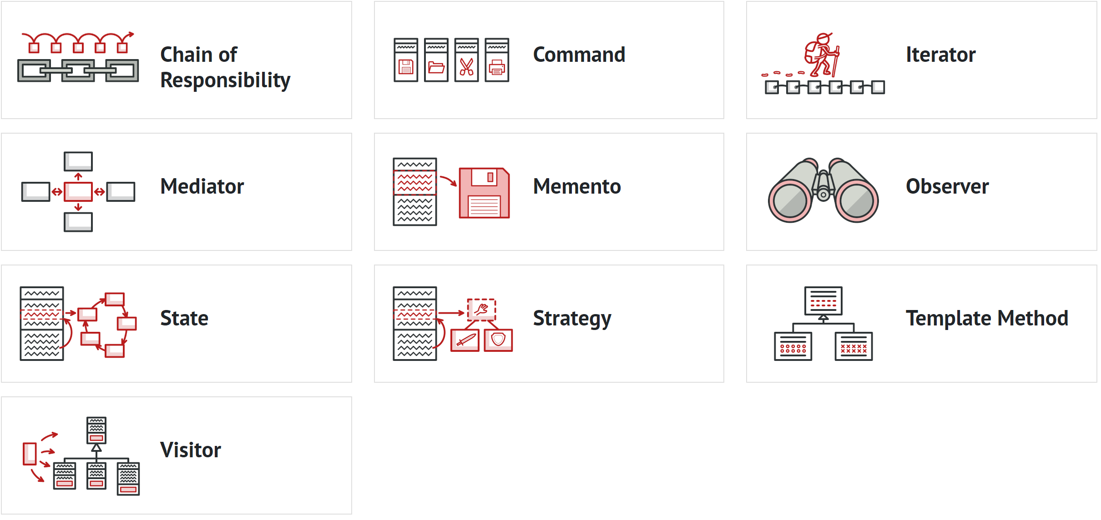
Behavioral Design Patterns
These patterns solve the problem of efficient and safe communication between program objects.

Slide 3
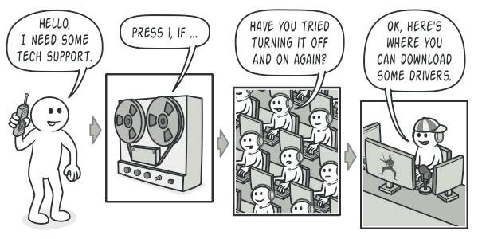
Chain of responsibility (Chain of Command)
Lets you pass requests along a chain of handlers. Upon receiving a request, each handler decides either to process the request or to pass it to the next handler in the chain.

Slide 4
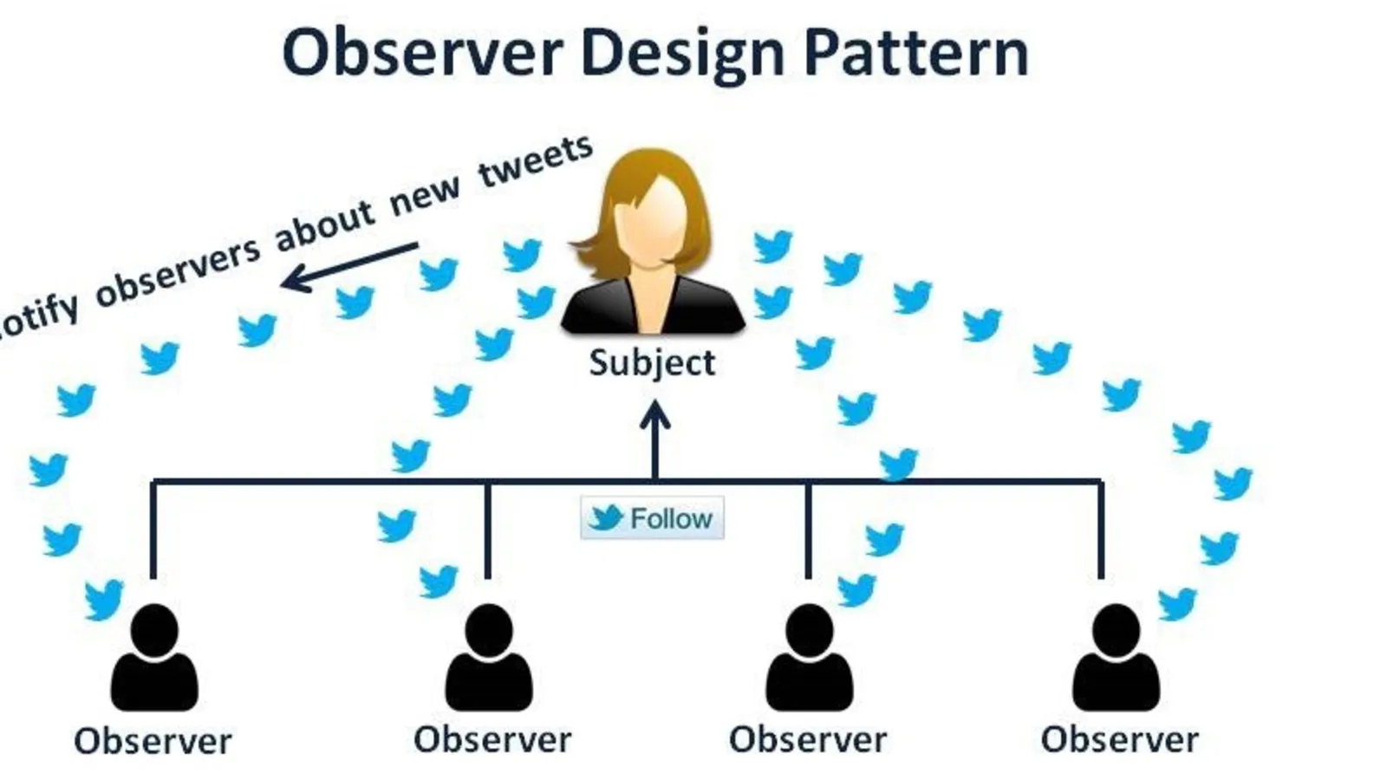
Observer
This pattern lets you define a subscription mechanism to notify multiple objects about any events that happen to the object they’re observing.

Slide 5
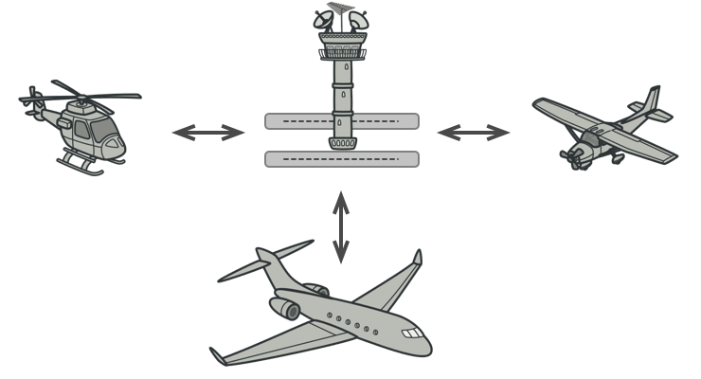
Mediator
lets you reduce chaotic dependencies between objects. The pattern restricts direct communications between the objects and forces them to collaborate only via a mediator object.

